Slide 1
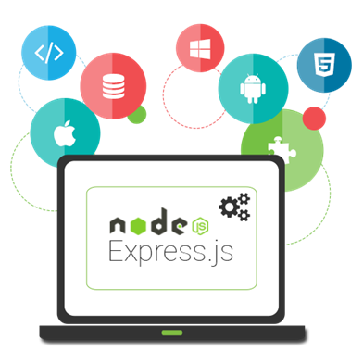
Intro to Express.js and View Engines
Router, Static Files, Middleware, Handlebars
SoftUni Team
Technical Trainers
Software University
http://softuni.bg

Slide 2
Table of Contents
Express
Introduction
Router
Middleware
Static Files
View Engines
Templating Concepts
Handlebars

Slide 3
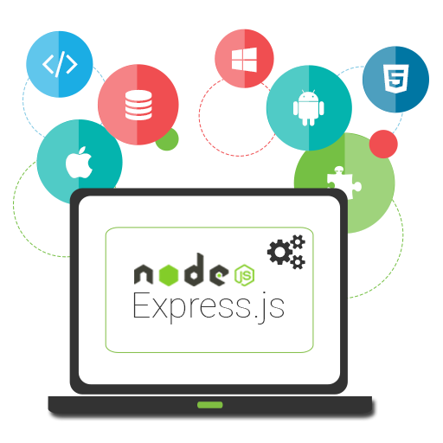
Introduction to Express.js
Installation, Configuration, Startup

Slide 4
Introduction to Express.js
Install express
npm install express –-save –-save-exact
let express = require('express')
let app = express()
const port = 1337
app.get('/', (req, res) => {
res.status(200)
res.send('Welcome to Express.js!')
})
app.listen(port, () => console.log(`Express running on port ${port}...`))
Create a new instance of the application

Slide 5
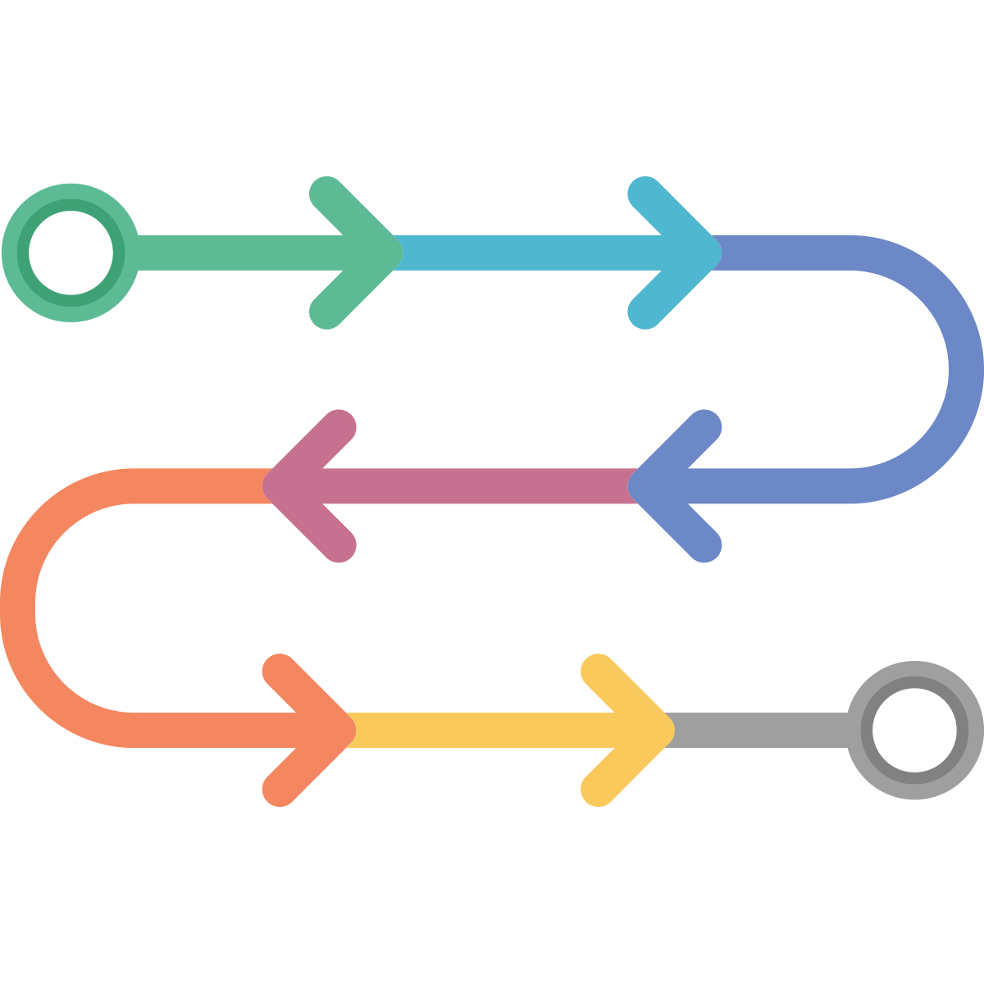
Router in Express.js
Handling request/response

Slide 6
Router
Routing has the following syntax
Where:
app is an instance of express
METHOD is an HTTP request method, in lowercase
PATH is a path on the server
HANDLER is the function executed when the route is matched
app.METHOD(PATH, HANDLER)

Slide 7
Route Methods
// GET method route
app.get('/', (req, res) => {
res.send('GET request to the homepage')
})
// POST method route
app.post('/', (req, res) => {
res.send('POST request to the homepage')
})
// PUT method route
app.put('/', (req, res) => {
res.send('PUT request to the homepage')
})

Slide 8
Route Methods
// All methods route
app.all('/about', (req, res, next) => {
console.log('Middleware execution..')
next()
}, (req, res) => {
res.send('Show about page.')
})
The next handler to be called
Shows the about page after middleware execution

Slide 9
Router Paths
Paths can contain special characters:
app.get('*',(req, res) => {
res.send('Matches everything')
})
app.get('/ab*cd', (req, res) => {
res.send('abcd, abANYTHINGcd')
})
app.get(/.*fly$/, (req, res) => {
res.send('butterfly, dragonfly') })
Based on string patterns
Based on regular expressions

Slide 10
Extracting Parameters
Paths can have parameters:
You can also validate parameters with regular expressions
app.get('/users/:userId', (req, res) => {
let paramsObj = req.params
res.send(paramsObj) })
app.get('/users/:userId(\\d+)', (req, res) => {
let paramsObj = req.params
res.send(paramsObj) })

Slide 11
Chainable routes
You can create chainable route handlers using 'app.route()':
app.route('/home')
.get((req, res) => {
res.send('GET home page') })
.post((req, res) => {
res.send('POST home page') })
.all((req, res) => {
res.send('Everything else')
})
Better for ordering routes
Always place 'all' as a final method

Slide 12
Router Responses
Responses:
res.download - prompt a file to be downloaded
res.end - end the response process
res.json - send a JSON response
res.jsonp - send a JSON response with JSONP support (cross-domain friendly)
app.get('/pdf', (req, res) => {
res.download('FULL PATH TO PDF') })

Slide 13
Router Responses
res.redirect - redirect a request (to another page)
res.sendFile - send a file as an octet stream
res.render - render a view template
https://expressjs.com/en/4x/api.html
app.get('/about/old', (req, res) => {
res.redirect('/about') })
app.get('/file/:fileName', (req, res) => {
let fileName = req.params.fileName
res.sendFile("PATH TO FILE" + fileName) })

Slide 14
Modular Routers
You can use express.Router for modular route handlers
Mounted on a route (e.g. '/about')
Can use middleware, specific only to that router
var express = require('express')
var router = express.Router()
router.use(/* add middleware */)
router.get(/* define route handlers */)
app.use('/about', router)

Slide 15

Middleware
Intercepting the HTTP

Slide 16
Middleware
Function that has access to:
The request and response object
The next middleware in the application's request-response cycle
Different kinds of middleware exist
Application, route, error
var app = express()
app.use((req, res, next) => {
console.log('Time:', Date.now())
next() })
Next handler to be called

Slide 17
Custom Middleware
Middleware can be only for specific path
app.use('/user/:userId', (req, res, next) => {
let userId = req.params.userId
// TODO: Check if user exists in db/session
let userExists = true
if (!userExists) { res.redirect('/login') }
else { next() } })
app.get('/user/:userId', (req, res) => {
res.send('User home page!') }
)

Slide 18
Third-Party Middleware (Body Parser)
https://github.com/expressjs/body-parser
const express = require('express')
const bodyParser = require('body-parser')
const port = 1337
let app = express()
app.use(bodyParser.urlencoded({ extended: true })) app.post('/login', (req, res) => {
console.log(req.body)
res.redirect('/home.html') })
app.listen(port, () => console.log(`Express running on ${port}`))

Slide 19
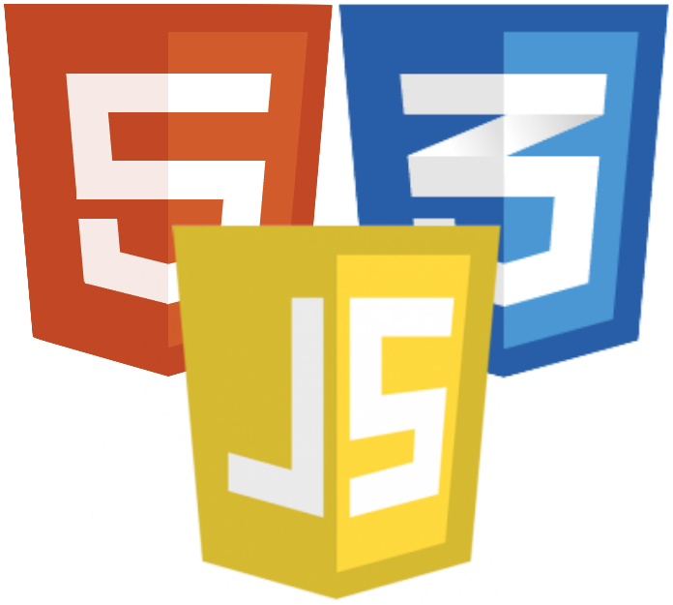
Static Files
Serve HTML, CSS, JS and other

Slide 20
Static Files
Serving static files:
And all files from the directory will be public:
app.use(express.static('public'))
app.use('/static', express.static('public'))
app.use('/static', express.static(__dirname + '/public'))
http://localhost:3000/images/kitten.jpg
http://localhost:3000/css/style.css
http://localhost:3000/js/app.js
http://localhost:3000/images/bg.png
http://localhost:3000/hello.html

Slide 21
Third-Party Middleware
http://expressjs.com/en/resources/middleware.html
app.set('view engine', 'pug');
app.set('views', __dirname + '/views');
app.use(cookieParser());
app.use(bodyParser());
app.use(session({secret: 'magic unicorns'}));
app.use(passport.initialize());
app.use(passport.session());
app.use(express.static(config.rootPath + '/public'));

Slide 22

Templating Concepts
Definition and Uses

Slide 23
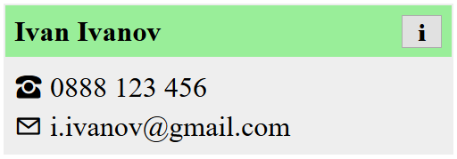

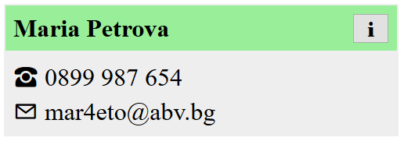
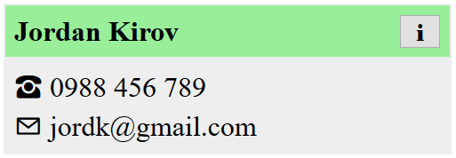
Templating
Allows similar content to be replicated in a web page, without repeating the corresponding markup everywhere
HTML
<div>
<span>
<button>
Dynamic
Ivan,
Maria,
Jordan, …

Slide 24
Templating Concepts
The static parts of a webpage are stored as templates
The dynamic content is kept separately (e.g. in a database)
A view engine combines the two
Benefits:
Productivity - avoid writing the same markup over and over
Easier upkeep - only change the code in one place
Composability - a single element can be used on multiple pages

Slide 25

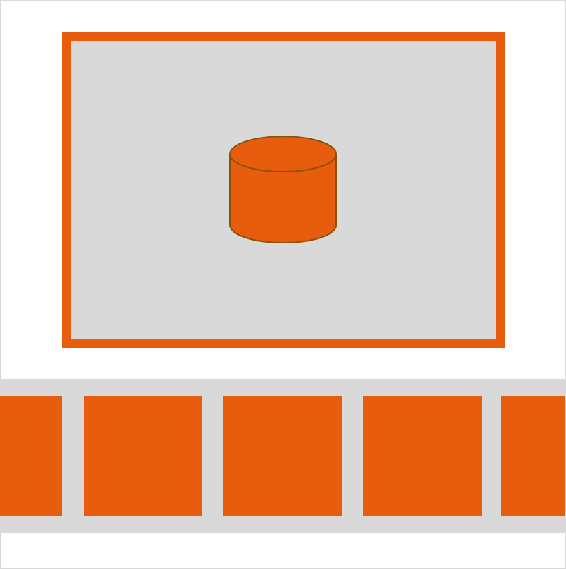

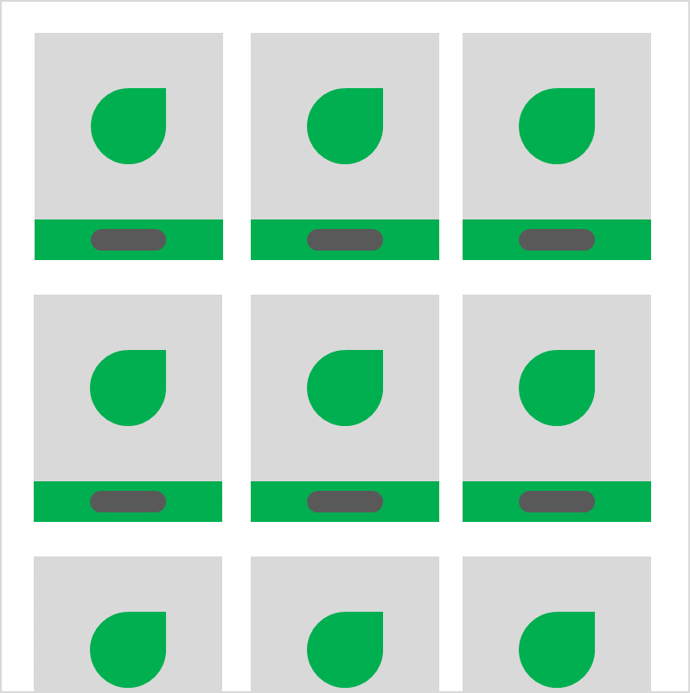
Examples
Display articles in a blog
Display a gallery of photos
Visualize user profiles
Show items in a catalog

Slide 26
Server View Engines
Server view engines return ready-to-use HTML to the client (the browser)
They parse the data to HTML on the server
Web applications, created with server view engines are not real SPA apps (In most cases)
Famous View Engines
Pug, Mustache, Handlebars, EJS, Vash

Slide 27

Templating with Handlebars
Syntax and Examples

Slide 28
Handlebars
Based on Mustache specification
Expressions are initialized with ' {{ ' and finish with '}}'
<div class="entry">
<h1>{{title}}</h1>
<div class="body">
{{body}}
</div>
</div>
<div class="entry">
<h1>My New Post</h1>
<div class="body">
This is my first post!
</div>
</div>

Slide 29
Integration in Express
npm install handlebars
npm install express-handlebars
const app = require('express')()
const handlebars = require('express-handlebars')
app.engine('.hbs', handlebars({
extname: '.hbs'
}))
app.set('view engine', '.hbs')
Set file extension

Slide 30
For-Loops
A template can be repeated for every entry in an array
let context = {
contacts: [
{ name: 'Maria Petrova', email: 'mar4eto@abv.bg'},
{ name: 'Jordan Kirov', email: 'jordk@gmail.com'} ]};
<ul id="contacts">
{{#each contacts}}
<li>{{name}}: {{email}}</li>
{{/each}}
</ul>
The expression inside
the loop uses each
entry as context

Slide 31
Conditional Statements
{{#if sunny}}
The sky is clear
{{else}}
The sky is overcast
{{/if}}
Variable to check
for truthiness
<ul id="contacts">
{{#each contacts}}
<li>{{name}}: {{email}}</li>
{{else}}
<i>(empty)<i>
{{/each}}
</ul>
Will be shown if
the array is empty

Slide 32
Partials
Templates that can be inserted into other templates
<div id="contacts">
{{#each contacts}}
{{> contact}}
{{else}}
<i>(empty)<i>
{{/each}}
</div>

Slide 33
HTML Escaping
By default, any strings that are evaluated will be HTML-escaped
To prevent this, use the "triple-stash"
title: "All about <p> Tags"
body: "<p>This is a post about &lt;p&gt; tags</p>"
<div class="entry">
<h1>{{title}}</h1>
<div class="body">
{{{body}}}
</div>
</div>
<div class="entry">
<h1>All About &lt;p&gt; Tags</h1>
<div class="body">
<p>This is a post about &lt;p&gt; tags</p>
</div>
</div>

Slide 34

Summary
…
…
…
Express.js is a fast web framework for Node.js
Middlewares can manipulate requests and responses
Templates speed up and simplify development
View Engines render templates
Handlebars offers effective templates and simple helper functions

Slide 35
https://softuni.bg/trainings/2452/js-back-end-september-2019

Slide 36












SoftUni Diamond Partners

Slide 37




SoftUni Organizational Partners

Slide 38




Trainings @ Software University (SoftUni)
Software University – High-Quality Education and Employment Opportunities
softuni.bg
Software University Foundation
http://softuni.foundation/
Software University @ Facebook
facebook.com/SoftwareUniversity
Software University Forums
forum.softuni.bg

Slide 39

License
This course (slides, examples, demos, videos, homework, etc.) is licensed under the "Creative Commons Attribution-NonCommercial-ShareAlike 4.0 International" license

